Slide 1
Free software is software that respects your
freedom and the social solidarity of your
community. So it's free as in freedom.
Richard Stallman
GNU/Linux
Naren Nallapareddy

Slide 2
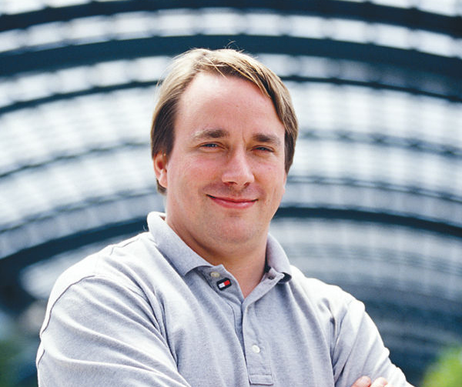
History of Linux
Unix-like (*nix) operating system
Based on Linux Kernel (released 1991) developed by Linus Torvalds
Started out of frustration of using education-use only Minix distribution
Several software libraries are provided by GNU (therefore, GNU/Linux)
Distributed under GNU GPLv2 licence initially
Was not intended to be Unix replacement
“Hello everybody out there using minix - I’m doing a (free) operating system (just a hobby, won’t be big and professional like gnu) for 386(486) AT clones. This has been brewing since april, and is starting to get ready. I’d like any feedback on things people like/dislike in minix, as my OS resembles it somewhat (same physical layout of the file-system (due to practical reasons) among other things). I’ve currently ported bash(1.08) and gcc(1.40), and things seem to work.”
Notes:
Dennis ritchie and ken thompson developed Unix in 70s
It was first multi-user multi-process portable operating system
DEC-pdp7
Before that it was time-sharing computers with punched cards
Minix was developed by andrew tennenbaum at Vrije
Richard Stallman started FSF in 85 whose goals was to make software free as in freedom

Slide 3
Why Linux?
Free for download; no licensing issues or costs
Freedom to share with your neighbor
Impervious to viruses
Full suite of software applications
Low resource use on hardware side
Ported to a large number of hardware
platforms: x86, ARM, PowerPC, MIPS, S/390, Super H, AMD x86-64, VAX
Available in almost any language
Flexible: can be run on everything from watches to supercomputers
Notes:
Full suite? You sometimes from time to time need to use proprietary software
You can install Linux on 20 Year old PC or TOP500 supercomputer. Runs equally well

Slide 4
Where is Linux used?
All TOP500 supercomputer use linux
96.55% of servers
All android smartphones are built on linux kernel
More generally:
Mac OS, and iOS are built on BSD which is based on UNIX
All of these are either POSIX certified (Mac OS) or mostly compliant (GNU/Linux, Android)
POSIX: The Portable Operating System Interface (POSIX) is a family of standards specified by the IEEE Computer Society for maintaining compatibility between operating systems.

Slide 5
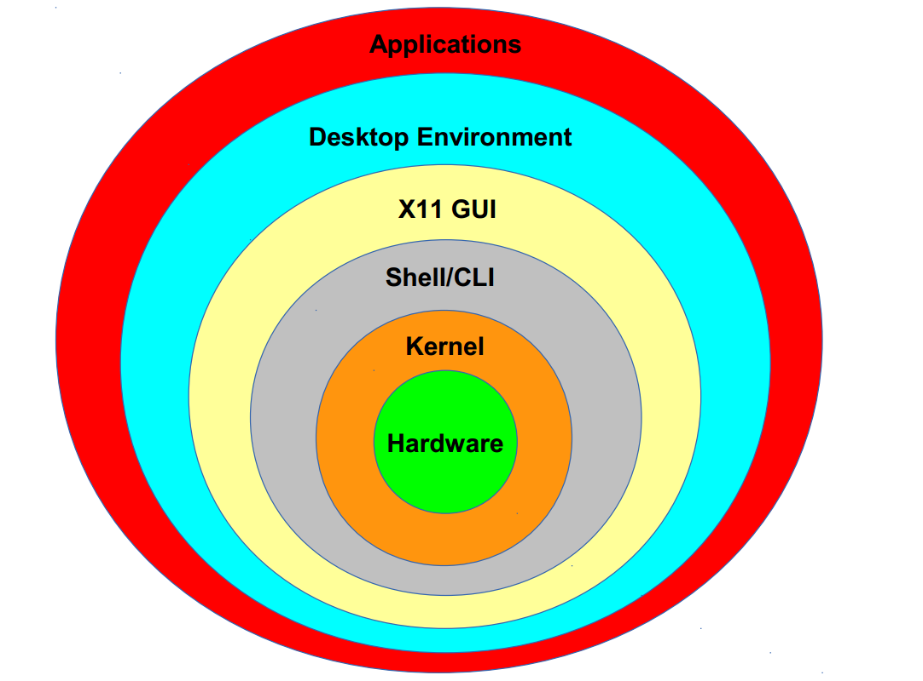

Slide 6
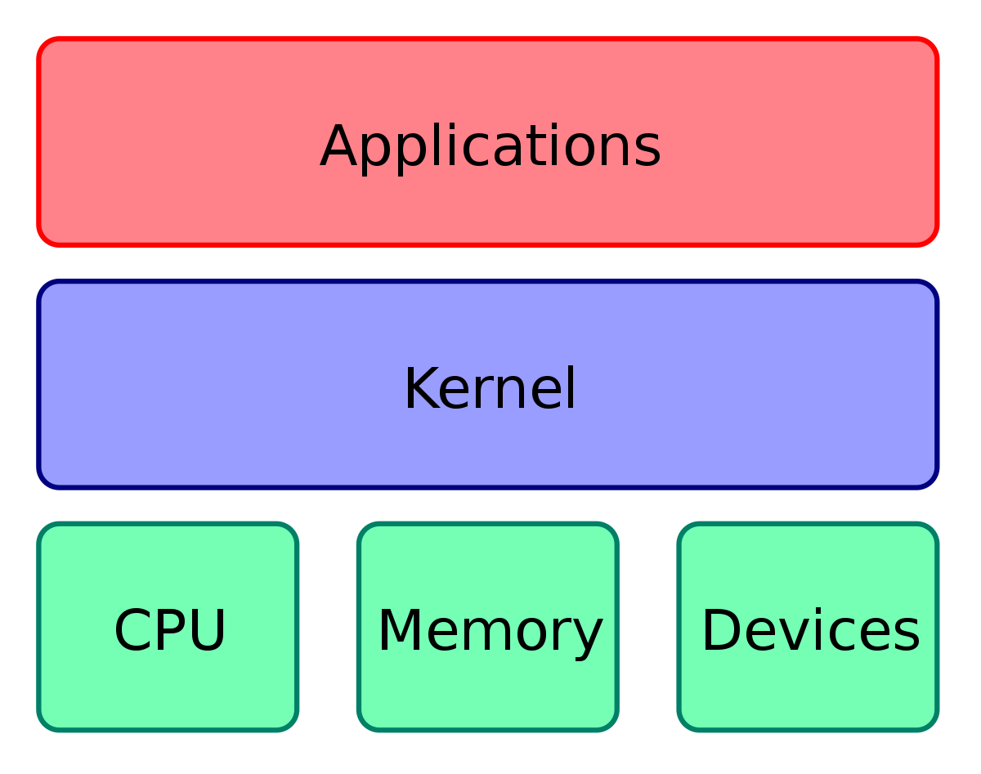
Linux
Linux kernel, which handles process control, networking, access to the peripherals, and file systems
GNU userland (also called user-space) performs input/output, manipulates file system objects, application software
CLI (command line interface) shell is a way for user to interact with the system. Issue commands, write code and run applications
Alternatively, GUI based interface. Also called windowing system on linux popularly based on X window system

Slide 7
Important components
Boot loader - Loads the Linux Kernel into memory after firmware initialization. GNU/GRUB is a popular bootloader
Init is the root process/daemon run at startup. In modern Linux OS it is systemmd
Package management system - manages a list of packages that can be downloaded and installed without much user interference. DPKG, and RPM the popular package manage systems
coreutils - GNU core utilities are used for basic file, and shell manipulation. Some of the commands like ls and cd are from coreutils

Slide 8
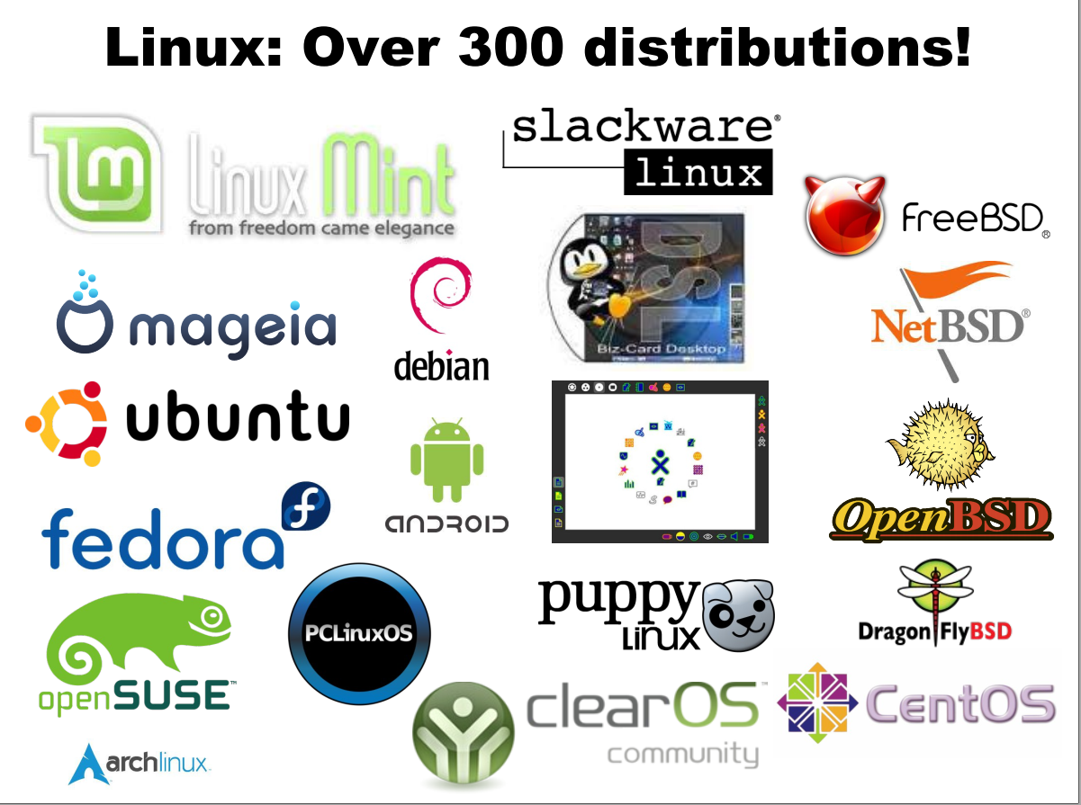

Slide 9
Ubuntu
Most popular Linux Distro (?)
Based off of debian stable branch
Default GUI is GNOME 3
Several variants and derivatives with different GUI
KUBUNTU
XUBUNTU
BUDGIE
Mint ...

Slide 10
Basic commands
pwd - current directory
ls - list files
cd - change directory
mkdir - make directory
echo - echo the line passed as argument
cat - concatenate and print to io
cp - copy source destination
mv - move source destination
rm - remove a file/directory
man - Manual page for the command
head - print from head
tail - print from tail
less - Print text without loading the whole file
more - kind of opposite of less
sort - sort in alphabetical order
grep - match the pattern and print line, can be used with regexp
which - which file is being executed when we run a command
chmod - change directory permissions
history - command line history
clear - clear ouput

Slide 11
Even more commands
shred - securely remove file
top - show running process and system utilization
touch - change file timestamps
ln - make a link
awk - command line utilities which are themselves programming languages built for text processing
date, cal - Current date and calendar
gzip, bzip2… - compression utilities
tar - create tarball files. Rolls directories into a single file, linux source code generally distributed as .tar.zip
uniq - removes repetetions
alias - maps one word to another
find - searchine through folders
wget - downloading files from web
apt-get (ubuntu and derivatives)

Slide 12
Installing Ubuntu
Pendrive with atleast 4 GB space
Unetbootin
Ubuntu 18.04 os
40 GB of space
EaseUS/Gparted to shrink a drive (if you don’t have a seperate drive for installation)

